Slide 1


AutoInt : Automatic Feature Interaction Learning via Self-Attentive Neural Networks Weiping Song, Chence Shi, Zhiping Xiao, Zhijan Duan, Yewen Xu, Ming Zhang, Jian Tang
Yayha Abdul Aziz, Yichen Lin, and Franck Benichou

Slide 2
1) Intro

Slide 3
2) Explaining the Pre Requisites

Slide 4
3) Related Works

Slide 5
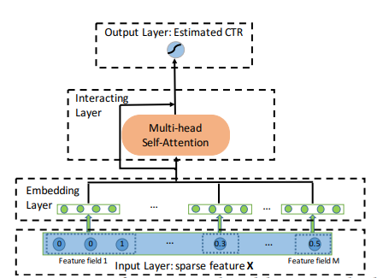
4) An Overview of the Autoint Algorithm
AutoInt Aims to:
Explicitly model different orders of feature combinations
Represent features into low dimensionality
Offer model explanability
Multi Head self Attention mechanism
3 layers:
Embedding layers
Interacting layer
Output Layer for CTR prediction
Notes:
AutoInt aims to explicitly model different orders of feature combinations, represent features into low dimensionality and offer good model explanability. It relies on multi head self attention mechanism.
Concretely, AutoInt learns effective low dimensional representations of the sparse and high dimensional input features, in the embedding layer, and is applicable to both the categorical and numerical features. It helps reducing the dimensionality of the input features and allow feature interaction.
The interacting layer, which is key to the AutoInt, promote the interactions between the features. In each of the interacting layer, each feature is allowed to interact with all other features and able to automatically identify relevant features to form meaningful higher order ones via the multi head attention mechanism. Given the multi head mechanism projects the features into multiple subspaces, it can then capture different interactions in different subspaces. By stacking the interacting layers, several feature interactions are identified. Finally, the attention mechanism measures the correlation between features to provide model explanability.

Slide 6
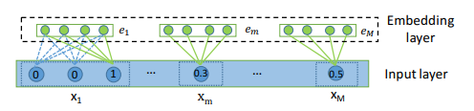



5) Input and Embedding Layer
Input Layer → user’s profiles and items’ attributes
Embedding Layer → Representation of categorical and numerical features in lower dimensionality
Representation of the categorical and numerical features in the same lower space enables interaction between numerical and categorical features
Notes:
First, let us discuss the input and embedding layer. The autoInt model takes the sparse feature vector x as input, followed by an embedding layer that projects all features into the same low dimensional space. The output of the embedding layer would be a concatenation of the multiple embedding vectors.
The user’s profiles and items’ attributes are in a sparse vector X which is the concatenation of all the fields. M is the number of total feature fields. It combines both numerical and categorical variable types.
To be compatible with multi valued features, embedding of categorical features also considers the average of corresponding feature embedding as in equation 3.
Numerical features are represented in the same low dimensional feature space as expressed in equation 4 to allow interactions with the categorical features.
Note:
Equation 3 → Vi is an embedding matrix for field i, and xi is an one-hot vector
Equation 4 → vm is an embedding vector for field m, and xm is a scalar value.

Slide 7
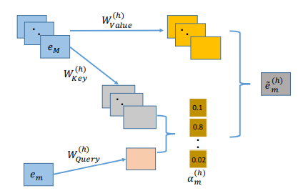
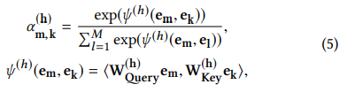




5) Interacting, Output layers and Training
Use of multi-head self attentive network to model the correlations between different feature fields
Similarity between features → use of an inner product function
Loss function: Log loss, parameters updated via gradient descent
Notes:
After all input features are embedded in the same lower dimension, the Auto-int can then model higher order interactions between features with a multi head self attention mechanism, to model the correlations between feature fields.
The correlation between feature m and feature k with a specific header h is described in equation 5 and Psi (h) is an attention function that defines the similarity between feature m and k. The chosen similarity function is inner product between the Query and Weights.
As shown by equation 6, the representation of feature m is updated by combining all relevant features through alpha m, k. and the value vector. Em in equation 6 represents a new combinatorial feature.
Multiple heads allow to identify the involvement of the same feature in different combinations since they create different subspaces and learn distinct features separately. The combinatorial features learned in all subspaces are then accumulated through concatenation as showed in equation 7.
The previously learned combinatorial features, from the previous heads are kept by adding a standard residual connection with RELU.
The output Layer, as showed in equation 9, is the application of a sigmoid with bias b on the concatenation of the combinatorial features.
Finally, the model training is done by minimizing a log loss function as showed in equation 10, through backpropagating the error with gradient descent
Note:
The parameters of the model are {Vi , vm, W (h) Query, W (h) Key, W (h) Value, WRes, w, b},

Slide 8
5) Analysis of AutoInt
Modeling Arbitrary Order Combinatorial Features
Hierarchical learning of feature interactions with attention mechanism
Low order feature interactions are carried by residual connections
Space Complexity
L-layer network: L ×(3dd′+d ′Hd) number of parameters
Output layer: d ′HM + 1 parameters
Interacting layers: O(Ldd′H)
Time Complexity
Calculating attention weights for one head: O(Mdd′ + M2d ′ )
Forming combinatorial features in one head: O(Mdd′ + M2d ′ )
Overall for H head: O(MHd′ (M + d))
Notes:
Based on the non linearity of activation function Relu, the non additive property of interaction function is held, meaning that second order feature interactions can be encoded in the output of the first interacting layer, where attention weights give useful feature combinations. Given the low order feature interactions are carried by residual connections, just a few interacting layers suffice to model high order feature interactions.
The space complexity is O(Ldd′H) and the authors chose H and d’ small to make the interacting layers memory efficient.
The time complexity is O(MHd′ (M + d)) which is efficient given the number of heads H and the embedding size d is usually small.

Slide 9
5) Experiment setup
The data and Performance evaluation
Criteo, Avazu, KDD12, MovieLens-1M
Infrequent observations removed and normalization of numerical feature + training/val/test : 80/10/10
Evaluation Metrics : AUC & LogLoss
Competing Models
Linear Regressions
Factorization Machines
Higher Order Feature Interactions Models
Implementation of AutoInt
3 interacting layers
H =2, d =16, d’=32
Grid search to fine tune hyper parameters
Optimizer : Adam
Notes:
The experiment uses benchmark CTR datasets Criteo and Movie Lens among others.
Infrequent observations are removed following a certain threshold, log normalization is applied and a classical partitioning of the data is done.
The AUC and logloss are used to compare AutoInt with competing models such as Linear Regressions, Factorization machines, and neural based Factorization Machines.
The AutoInt and all other models are implemented in TensorFlow. For this experiment, the AutoInt has 3 interacting layers, 2 heads at each layer. Grid seach is applied to fine tune drop out and the hyper parameters while the Adam optimizer is chosen.

Slide 10
5) The Experiments

Slide 11
6) Results and Discussions

Slide 12
6) Critiques (Advantages and Disadvantages)

